Slide 1





PRESENTATION 2026
Selflogic- slow moving inventory risk detection
Mentor Name
Student Name
Student Email
UMA MAHESWARI
KRUPA SOLANKI
krupa111666@gmail.com

Slide 2

Outline
Abstract of the Project
Problem Statement
Proposed Solution
System Architecture
Live Demo of the Project
Embedded Video of Project
Conclusion
Future Scope

Slide 3
Abstract
This project focuses on analyzing inventory data to identify slow-moving and high-risk products. The dataset was cleaned and processed using Excel, and an interactive dashboard was created using Power BI to visualize insights.
Key Highlights:
Identifies high-risk inventory
Uses Excel & Power BI
Supports better decision-making

Slide 4

Problem Statement
Managing inventory efficiently is a major challenge for businesses, especially in identifying slow-moving and high-risk products. Traditional methods lack intelligent insights and real-time analysis. There is a need for a system that integrates data analysis with AI-based support to improve decision-making in inventory management.

Slide 5

Proposed Solution
The proposed solution involves cleaning and analyzing inventory data using Excel, where key metrics such as turnover ratio and risk levels are calculated. The processed data is then visualized through an interactive dashboard in Power BI. AI tools like ChatGPT and Copilot were used for guidance during the project. This solution helps in identifying high-risk and slow-moving products, enabling better and faster decision-making.

Slide 6
Inventory Pyramid
High Risk → Slow-moving products
Medium Risk → Moderate movement
Low Risk → Fast-moving products

Slide 7
AI Tool Used – Copilot Studio
Microsoft Copilot Studio was used as an AI support tool in this project. It helped in understanding data analysis concepts, improving workflow, and assisting in report and presentation creation. The use of AI enhanced efficiency and made the project development process more effective.

Slide 8
System Architecture
Data Input / Source
Processing / Analysis
The dataset includes product details such as stock quantity, sales, price, supplier, and customer ratings. The data is created and managed in Excel
Data cleaning, transformation, and calculation of turnover ratio are performed in Excel. Risk levels are categorized into high, medium, and low based on performance
AI / Tool Integration
Output / Dashboard
Tools like Excel and Microsoft Power BI are used for analysis and visualization. Power BI provides interactive dashboards with charts, KPIs, and slicers.
The final output is a dashboard that includes KPIs, charts, and filters to analyze inventory performance and risk levels

Slide 9
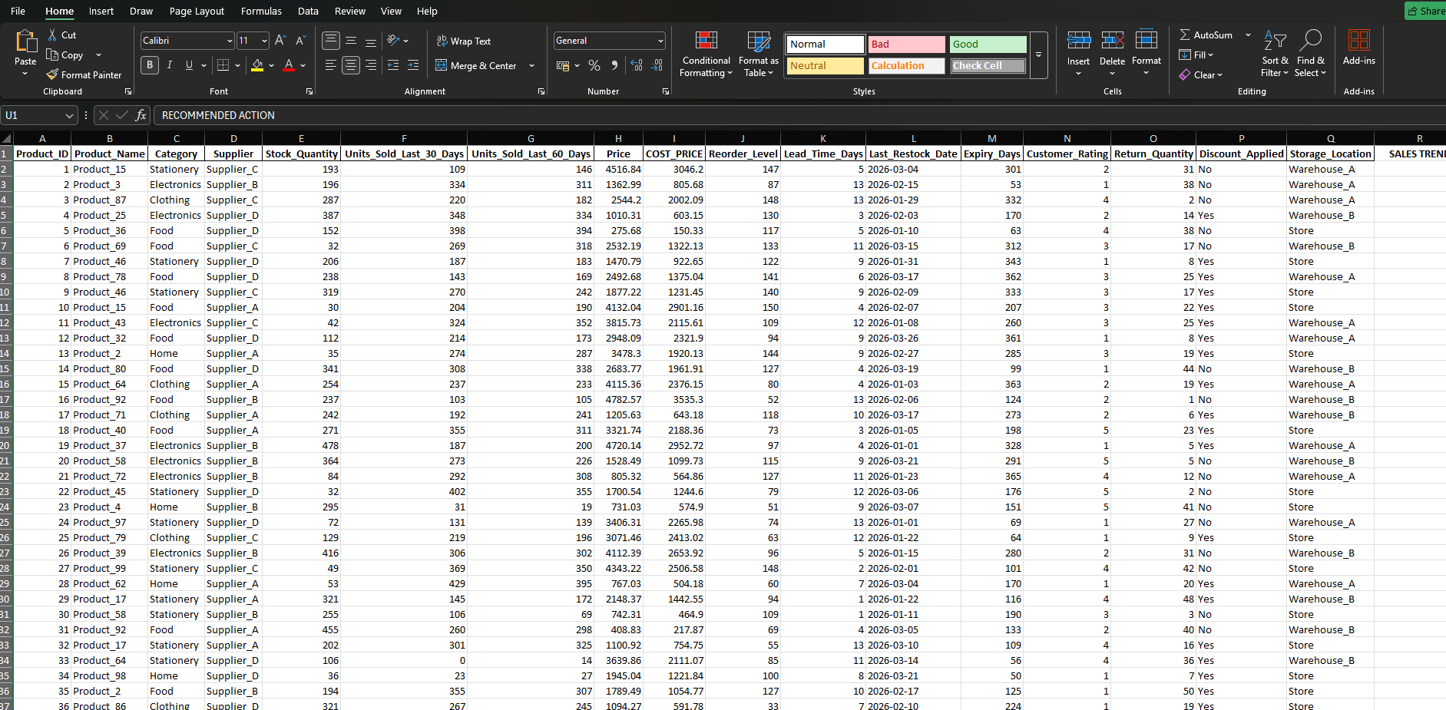
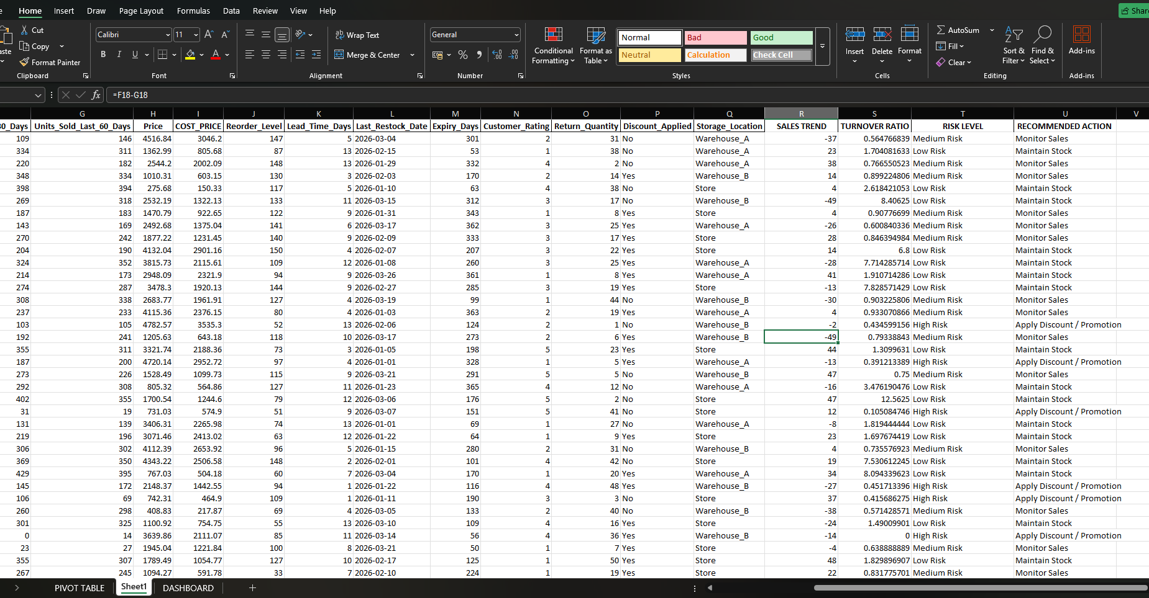
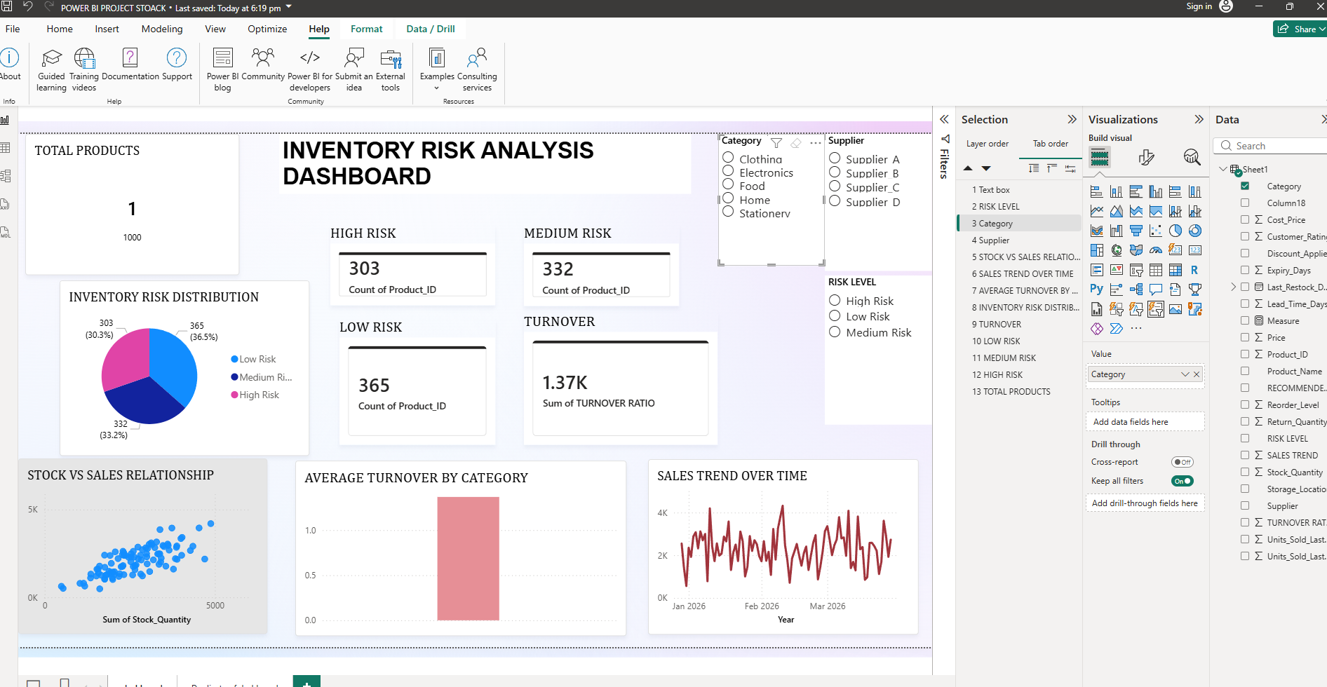
Live Demo of Project
Here's the list of some demo screenshots / features of the project:
dataset
Clean dataset
dashboard
Demo 1
Demo 2
Demo 3
[Add description of Demo 1 here — what this demo shows, key features, and results achieved.]
[Add description of Demo 2 here — what this demo shows, key features, and results achieved.]
[Add description of Demo 3 here — what this demo shows, key features, and results achieved.]

Slide 10
Video of Project Demo
https://drive.google.com/file/d/1fIB-vVBzII-oBPBW7fUvcKi33HVnxi5x/view?usp=drive_link
▶
[Insert your project demo video.
You can embed a video your live project.]

Slide 11

Conclusion
This project successfully accomplished the objective of analyzing inventory data to identify high-risk and slow-moving products. Key results include the calculation of turnover ratios, classification of products into different risk levels, and the development of an interactive Power BI dashboard for clear visualization. The findings highlight how data-driven insights can improve inventory tracking and decision-making. All project objectives were achieved, and this solution adds value by providing a simple, efficient, and visual approach to inventory management.
CONCLUSION

Slide 12

Future Scope
This project can be further enhanced by integrating advanced AI and machine learning techniques for predictive analysis of inventory trends. Additional features such as real-time data integration, automated alerts for high-risk products, and mobile-friendly dashboards can be implemented. The system can also be scaled for larger datasets and integrated with business management software to improve overall efficiency and decision-making.

Slide 13
Thank You
AICW Fellowship | Student Project Presentation 2026
LinkedIn | Edunet Foundation

